Slide 1
Inter-Process Communication (IPC) (Communication between Microservices)
Notes:
IPC concepts are applicable to both (micro)services and monolithic applications

Slide 2
Module Outline
Objectives
On completing this module, you will be able to:
Demonstrate an understanding of the need for communication among processes and (micro)services
Explain basic communication patterns among processes and (micro)services
Understand variants of communication (transport) technologies
Topics
Communication patterns
Communication (transport) technologies

Slide 3
Communication
As defined by Cambridge Dictionary, communication is:
the process of sharing information, especially when this increases understanding between people or groups:
Transfer and exchange information
Collaborate
Between enterprises, enterprise applications, software, (micro)services, etc.

Slide 4
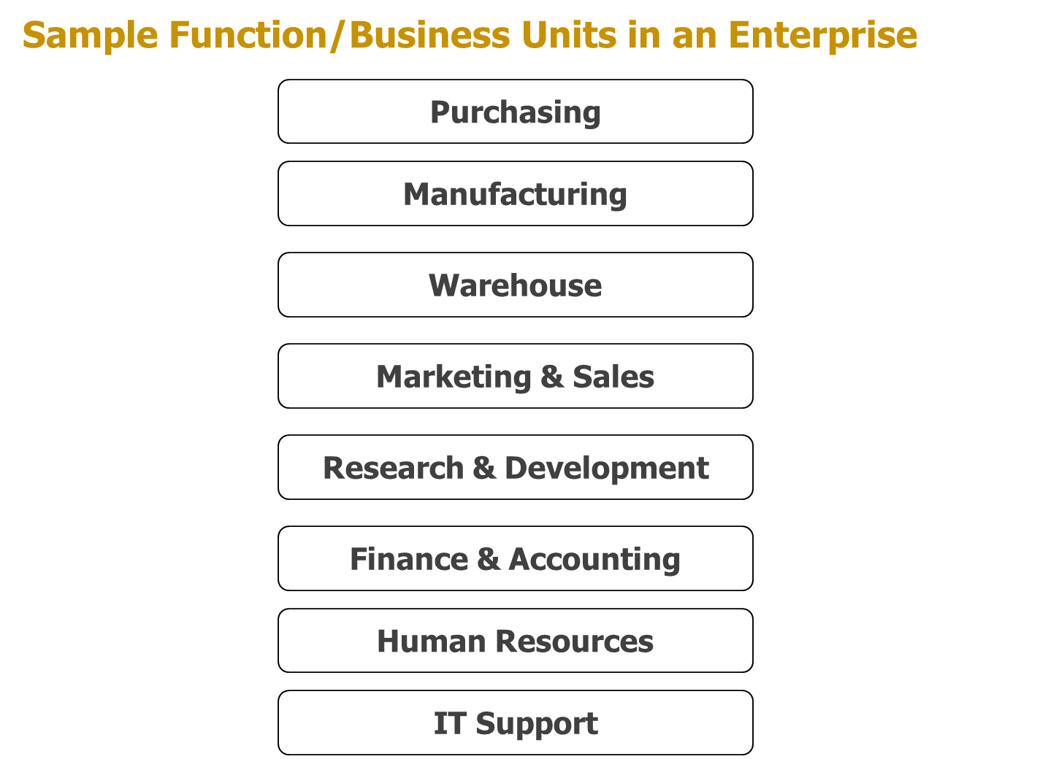
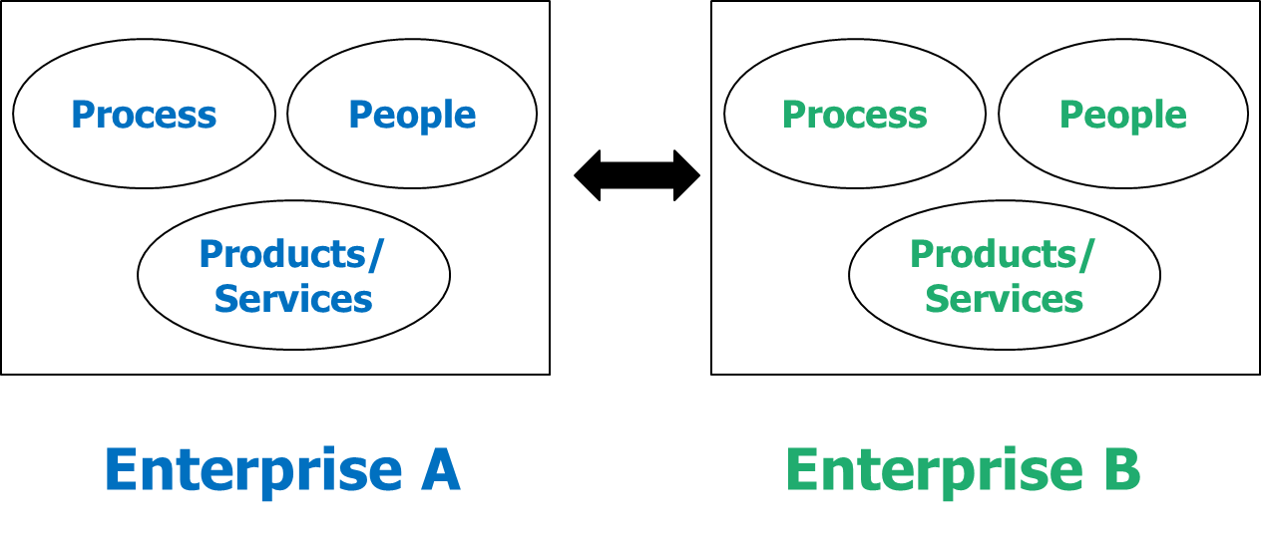
Need for Communication Among Processes
Enterprise applications often need to use each other's functions or services, and exchange data, in order to realize business processes, within and between enterprises
Notes:
Notes about the term "process":
"processes" here refer to software processes running on a platform, not business processes. E.g., you can see the processes on Windows by using "Task Manager". However, software processes can be used to implement business processes.
(Software) processes usually refer to the dynamic, runtime instances of a software application; the same software application can have multiple processes (instances) running at the same time.

Slide 5

Need for Communication Among Microservices
Each microservice often implements functions for one entity only
Example entities: customer, account, product, order, payment, etc.
Microservices can be deployed separately to different machines
Each run of a microservice is a separate process in the OS in a machine
Implementing a business process may require collaboration among more microservices than monolithic applications
More communication among microservices across networks may be needed
A status change in a microservice may induce changes in other microservices, triggering communications
User interfaces need communications with underlying microservices
MS4
MS1
MS2
MS5
MS3

Slide 6
Communication Patterns

Slide 7
Basic Terms
Send Data, or Request Data
Sender
Receiver
Communication Channel
Data
Data

Slide 8
Basic Terms
Reply Data, or Reply Status, or Response
Sender
Receiver
Communication Channel
Reply Data

Slide 9
Synonyms
Send: produce, push, publish, broadcast, request, trigger, …
Sender: producer, publisher, caller, requestor, …
Receive: accept, consume, take, get, retrieve, acquire, pick up, …
Receiver: listener, consumer, subscriber, callee, …
Wait to receive: wait for, listen for, subscribe for a piece of data, …
Reply: response, feedback, return, …
Notes:
Senders/receivers are NOT mutually exclusive: A sender can become a receiver when receiving a reply; a receiver can become a sender when forwarding data to another receiver.
Which synonyms to use may depend on business scenarios and the communication technologies used.

Slide 10
Categorization Criteria for Communication Patterns
How many receivers does the sender expect for the same data sent?
One receiver: one-to-one
Many receivers: one-to-many
All receivers: one-to-all
Selected receivers: one-to-selected (can be zero, one, multiple, or all)
Does the sender expect a reply for the data sent?
No: fire-and-forget (fire & forget, one-way)
Yes: request-reply (request-response)
Do the sender and the receiver need to be online at the same time to realize the communication?
Yes: synchronous (synchronized, sync.)
No: asynchronous (asynchronized, async.)

Slide 11
How many receivers does the sender expect for the same data sent? (1/3)
One receiver: one-to-one
E.g.,
Mail a letter to a person
Email to one address
Data
Sender
Receiver

Slide 12
How many receivers does the sender expect for the same data sent? (2/3)
All receivers: one-to-all
E.g.,
Email to all SMU addresses
Public Warning System sounds an emergency message
Receiver 1
Data
Sender
……
Receiver n
Notes:
A sender can simulate one-to-many by repeating one-to-one many times.

Slide 13
How many receivers does the sender expect for the same data sent? (3/3)
Selected receivers: one-to-selected
E.g.,
WhatsApp to a group
Email to selected SMU addresses
Selected Receiver 1
Data
Sender
……
Selected Receiver n

Slide 14
Does the sender expect a reply for the data sent? (1/2)
No: fire-and-forget (FF)
E.g.,
Send an anonymous suggestion letter
Radio broadcasting
TV news reporting
Data
Sender
Receiver

Slide 15
Does the sender expect a reply for the data sent? (2/2)
Yes: request-reply (RR)
E.g.,
Phone call
Place an order for a book
Post a question on a discussion forum
Request data
Sender
Receiver
Reply data

Slide 16
Do the sender and the receiver need to be online at the same time? (1/2)
Yes: synchronous
May or may not have reply data. E.g.,
Phone call
Place an order for a book
Radio broadcasting
Request data
Sender
Receiver
Reply data
Notes:
The dashed lines indicate that some data transmission may not actually happen.

Slide 17
Do the sender and the receiver need to be online at the same time? (2/2)
No: asynchronous
May or may not have reply data
Usually have some intermediary(-ies). E.g.,
Mail a letter to a person
The post office is the intermediary
Email to all SMU addresses
The SMU email server is the intermediary
Request data
Request data
Sender
Inter-mediary
Receiver
?
?
?
Reply data
Reply data
Notes:
The dashed lines and question marks indicate that some data transmission may not actually happen.
The senders and receivers usually don't communicate with each other directly; instead, they communicate with some intermediaries.
All the previous basic patterns can be combined together to form complex patterns; e.g., taxi booking: what happens between a passenger making a phone call to book a taxi and the taxi drivers?

Slide 18
Communication Technologies

Slide 19

Communication Technologies (a.k.a. Protocols)
Used to implement various communication patterns
Invocation-based: data goes point-to-point
Usually synchronous. E.g., function (method) call; HTTP; gRPC
Message-based (a.k.a., messaging): data goes through a message broker or intermediary(-ies)
Usually asynchronous.
E.g., AMQP, JMS, IPFS, …
Microservice A
Microservice B
Microservice C
Microservice B
Microservice A
Message Intermediary (-ies)
Microservice C
Notes:
Lines here indicate the existence of communication; they do not indicate a particular communication pattern.
Various patterns can be implemented via either invocation-based or message-based technologies.
Message brokers or other kinds of message proxies are also collectively known as message intermediaries.
AMQP: Advanced Message Queuing Protocol
-----
Beyond the course scope:
JMS: Java Message Service
IPFS: InterPlanetary File System
The message intermediaries can be either centralized or decentralized or even distributed.
Software implementing AMQP and JMS are centralized;
TIBCO Rendezvous Certified Message Delivery software is decentralized/distributed.
IPFS is distributed, can be used to implement a peer-to-peer messaging app, e.g., Berty
ZeroMQ (a.k.a., ØMQ, 0MQ, or ZMQ) is distributed, for peer-to-peer messaging; all the peers/points in the network collectively provide the capabilities of a message broker.
My own notes:
For message-based, receiver doesn’t need to know the ip address or port number of the sender and vice versa. They only need to know that of the message intermediary.
Sender also wont know the status of the receiver, just need to know status of the intermediary
If intermediary fails then everything fails
For invocation based,if one microservice fails, the others can still work

Slide 20
Sample Use Cases
Invocation-based: point-to-point
Phone call: a sender connects to a receiver by dialling a phone number; communication fails if the receiver doesn't answer
Web browsing (via HTTP): a web browser takes us to an URL; communication fails (e.g., 404) if the website doesn't respond properly.
Message-based: through some message intermediary(-ies)
Email: a sender sends an email to an address; the sender needs to connect to an email server to do so; the email may go through many email servers before reaching the receiver’s email server; the receiver may or may not receive the email at the time.
Phone voice message box: "leave a message"; the phone server stores the message, waiting for the receiver to retrieve the message sometime later.
WhatsApp messaging: two ticks for each message sent; one indicates the message reaches the server; the other indicates the message reaches the receiver's phone.
Notes:
Invocation-based calls often have returns, even if return values can be empty or of no use.

Slide 21


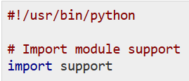

Example: Language-Level Function Call in Python
Function 1- support.py
callee
Output
function (method) calls as a communication mechanism
Arguments and/or return values
(if any) passed along with function calls
Function 2- letter.py
caller
Source: https://www.tutorialspoint.com/python/python_modules.htm
Notes:
Function calls are language-dependent.

Slide 22


HTTP Request-Response (RR)
HTTP Request
HTTP Connection
URLs
HTTP Response
HTTP Client
HTTP Server
(Web Server)
Commonly used HTTP Request Methods | Intended meaning
POST | Create data on the server
GET | Retrieve data from the server
PUT | Update data on the server
DELETE | Delete data from the server
Notes:
"Request-Reply" is often used as a synonym of Request-Response; both are abbreviated as RR.
A client doesn't need to know the language or platform used to implement the server, as long as it knows the URLs and how to send http request and receive http reply.
A client doesn't have to be a web browser.
We'll learn using python and its built-in "requests" module to send HTTP requests and receive responses.

Slide 23
Messaging (Publish-Subscribe)
Shipping Record Service
"order 123 created"
Message Broker
Subscriber
Order Service
"order 123 created"
A channel for "order"
Activity Log Service
Publisher
"order 123 created"
Subscriber
A (micro)service can publish a message to a certain communication channel maintained by the broker. A message can be used to send detailed information, or simply indicate an event when something notable happens. For example, a message may contain the actual details of an order or simply an event---"a new order 123 created".
Other (micro)services subscribe to the channels maintained by the broker. The broker relays messages to the appropriate (micro)services subscribed to the appropriate channels.
When a (micro)service receives a message, it can update its own data entities, which might raise more events or lead to more messages being published.
Notes:
An event is also data, although usually simpler/less informative.
If a message is sent before a receiver subscribes to a channel, would the receiver receives the message after it subscribes to the channel?
-> Yes and No, depending on the settings of the broker and the channel and the message: if their “time-to-live” (TTL) are long enough (e.g., set to be durable or persistent, and they don’t expire), then they can keep the message alive until some receiver receives the message; otherwise, no.

Slide 24
Messaging (Publish-Subscribe)
When two or more (micro)services collaborate through messages that are sent/received via a broker, the publisher is loosely coupled from the subscriber:
When a message is sent, the subscriber does not have to be online;
The handling of a message does not have to happen immediately after the message is received;
Handling of the message can happen whenever the subscriber is ready to do so; the subscriber may or may not reply back to the publisher; the reply may even come from another (micro)service.
Notes:
E.g., an order is created via an order microservice and sent to warehouse microservice for packaging and shipping which involves external courier service; later, the courier service (not the warehouse service) replies to the order microservice to update the order status.
In contrast, for invocation-based communications, the callee must be online when a call happens, and usually returns to the caller shortly (unless a failure happens).

Slide 25
Characteristics of Communication Technologies
Invocation-based | Message-based
Data goes from point-to-point directly | Data goes through some message intermediary(-ies)
Usually for one-to-one communication | The intermediary can help to facilitate one-to-many communication
In case of receiver failure or offline, no intermediary to store data and sender cannot send data | In case of receiver failure or offline, sender can still send data and the intermediary can store the data and deliver it later
Sender needs to know all of its receivers (unless the receivers are hidden behind subnetworks, load balancers, API gateways, etc.) | Sender and receiver may not need to know each other, but need to know the interfaces of the message intermediary
Usually sender determines which receiver to receive data | The intermediary affects which receiver to receive data
Senders and receivers need to be online at the same time, so that they are more "tightly coupled" | Senders and receivers do not need to be online at the same time as long as the intermediary is online, so that they are more "loosely coupled"
No intermediary to maintain | Need to maintain the intermediary(-ies)
Notes:
One-to-one communication via invocation can be used to simulate one-to-many, by repeating one-to-one invocations many times (every time sending the same data to a different receiver).

Slide 26
Similar Terms for Data
Data, information, message, content, and value are mostly treated as synonyms in this course, although they have subtle differences.
Data
Most general among the terms; it refers to any symbols or signs of something (e.g., a situation, person, company, product, account, etc.), whether understandable or not.
Information
Understandable data about facts or details of something.
Message
Data that is usually stored in transient memory (in contrast to persistent files, databases, external storages, etc.)
Content
Information that is more relevant to a specific business scenario
E.g., the content of a message may refer to the business information and networking information in the message
Value
An actual piece of information about a particular fact or detail
E.g., an argument value in a function call
Notes:
This course treats all the terms as synonyms, although they have different meanings in practice, which are beyond the scope of this course. Also, may refer to DIKW (Data, Information, Knowledge, Wisdom) pyramid https://en.wikipedia.org/wiki/DIKW_pyramid

Slide 27
Sample Data/Message Format - JSON
{
"orders": [
{
"customer_id": "Apple TAN",
"order_id": 5,
"order_item": [
{
"book_id": "9781434474234",
"item_id": 3,
"order_id": 5,
"quantity": 1
},
{
"book_id": "9781449474212",
"item_id": 2,
"order_id": 5,
"quantity": 1
},
…
],
"timestamp": "Wed, 14 Nov 2018 22:42:31 GMT"
},
…
Notes:
For this sample,
Data: is about the JSON data; can be a JSON file (usually in hard disk) or a JSON message (usually in memory);
Information: is about a JSON object containing a key/name-value pair ("orders" is the name/key; the value is an array of other key/name-value pairs…);
Content: is about a list of orders, likely for a book ordering scenario;
Value: is about the specific values in the orders, e.g., "Apple TAN" is a value; "9781434474234" is another value; …
For communications, sending data/information/message/content/value/file/etc. are all possible, depending on the traditions for describing particular scenarios or contexts and how much specific details the description is intended to provide.

